Slide 1

AWS Step Functions for Automated Order Processing in E-commerce
Name of the student: Thatiparti Taniswi (2210030402)
Under the esteemed guidance of Ms. P. Sree Lakshmi
Assistant Professor, Department of Computer Science and Engineering

Slide 2
Project Overview
Problem: Manual processing in e-commerce causes delays and errors.
Objective: Automate the entire order processing lifecycle using AWS Step Functions.
Real-world relevance: Enhances customer satisfaction by providing faster, error-free order handling.

Slide 3
Services Used
AWS Lambda: Executes tasks like validation, payment authorization.
Amazon API Gateway: Provides endpoints for frontend communication.
Amazon DynamoDB: Stores and tracks order states.
Amazon SQS: Decouples services for reliable order messaging.
AWS IAM: Manages permissions securely.

Slide 4
Flow Diagram
Architecture Overview:
Frontend -> API Gateway -> Lambda (Validation) -> DynamoDB
Lambda (Authorize Payment) -> Lambda (Record Purchase)
SQS handles message buffering.
Monitoring via CloudWatch.
(Tools Used: AWS Console, AWS SDKs)

Slide 5
Implementation Process
Created DynamoDB table (PurchaseID as Partition Key).
Created and configured SQS (PurchaseQueue).
Built Lambda functions: OrderValidation, AuthorizePayment, RecordPurchase.
Designed Step Function State Machine.
Connected all services ensuring proper event-driven flow.

Slide 6
Key Features and Functionality
Automated end-to-end order processing.
Serverless design for scalability.
Asynchronous message handling using SQS.
Monitoring and alerting with CloudWatch.
Secure access management through IAM.

Slide 7
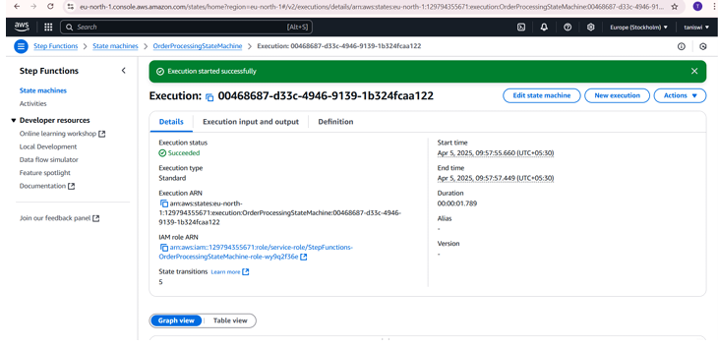
Results and Outputs
Successful execution of workflows through Step Functions.
Payment authorization, order validation, and recording completed.
Logs captured, no major failures observed.
High reliability and reduced latency.

Slide 8
Challenges and Solutions
Challenges:
Handling async workflows.
Securing APIs.
Solutions:
Used SQS for decoupling.
Applied strict IAM policies.

Slide 9
Learnings & Takeaways
Technical:
AWS Step Functions, Lambda, DynamoDB, SQS, IAM.
Soft skills:
Cloud architecture design.
Debugging serverless workflows.

Slide 10
Future Scope
Add real-time SNS notifications.
Enhance security via API throttling.
Scale up for large order volumes.
Cost optimization via reserved concurrency.

Slide 11
References
[1] Amazon Web Services (AWS). (2024). AWS Step Functions – Overview. Available at https://aws.amazon.com/step-functions
[2] AWS Documentation. (2024). Automating Workflows with Step Functions. Available at https://docs.aws.amazon.com/step-functions
[3] Amazon Web Services (AWS). (2024). Step Functions and Order Processing. Available at https://aws.amazon.com/blogs/architecture/
[4] Cloud Performance Journal. (2023). Workflow Optimization in E-commerce. Available at https://cloudperformancejournal.com
[5] U.S. Department of Homeland Security. (2023). API Security Best Practices. Available at https://www.dhs.gov/api-security

Slide 12
THANK YOU

